Slide 1


HEART DISEASE DIAGNOSTIC ANALYSIS
Megha Patil

Slide 2
PROJECT DETAIL
Project Title | Heart Disease Diagnostic – Analysis
Technology | Business Intelligence
Domain | Healthcare
Project Difficulty level | Advanced
Programming Language Used | Python
Tools Used | Google Colab, MS-Excel, MS-Power BI

Slide 3
OBJECTIVE
The objective of this project is to examine the incidence of heart disease, utilizing a set of characteristics that depict the condition.

Slide 4
PROBLEM STATEMENT
▶ Health is real wealth in the pandemic time we all realized the brute effects of covid-19 on all irrespective of any status. You are required to analyse this health and medical data for better future preparation.
▶ A dataset is formed by taking into consideration some of the information of 303 individuals.

Slide 5


ARCHITECTURE
Data Pre-Processing
Data Collection
Importing Libraries in google colab
Load Dataset
Missing Value Imputations
Handling
Outliers
Data Cleaning
Real World
Power BI
Desktop
Modelling
Exploratory Data Analysis (EDA)
Data Visualization

Slide 6
DATASET INFORMATION
exang: Exercise induced angina (1 = yes; 0 = no)
oldpeak: ST depression induced by exercise relative to rest
slope: the slope of the peak exercise ST segment (Value 1: upsloping, Value 2: flat, 3: down sloping)
ca: The number of major vessels (0-3)
thal: A blood disorder called thalassemia (3 = normal; 6 = fixed defect; 7 = reversable defect)
num: Heart disease (0 = no, 1 = yes)
age: The person's age in years
sex: The person's sex (1 = male, 0 = female)
cp: The chest pain experienced (Value 1: typical angina, Value 2: atypical angina, Value 3: non-anginal pain, Value 4: asymptomatic)
trestbps: The person's resting blood pressure (mm Hg on admission to the hospital)
chol: The person's cholesterol measurement in mg/dl
fbs: The person's fasting blood sugar (> 120 mg/dl, 1 = true; 0 = false)
restecg: Resting electrocardiographic measurement (0 = normal, 1 = having ST-T wave abnormality, 2 = showing probable or definite left ventricular hypertrophy by Estes' criteria)
thalach: The person's maximum heart rate achieved

Slide 7
Age: Age is the most important risk factor in developing cardiovascular or heart diseases, with approximately a tripling of risk with each decade of life. Coronary fatty streaks can begin to form in adolescence. It is estimated that 82 percent of people who die of coronary heart disease are 65 and older. Simultaneously, the risk of stroke doubles every decade after age 55.
Sex: Men are at greater risk of heart disease than pre-menopausal women. Once past menopause, it has been argued that a woman's risk is similar to a man’s although more recent data from the WHO and UN disputes this. If a female has diabetes, she is more likely to develop heart disease than a male with diabetes.
Fasting Blood Sugar: Not producing enough of a hormone secreted by your pancreas (insulin) or not responding to insulin properly causes your body's blood sugar levels to rise, increasing your risk of heart attack.
Important Parameters
Max heart rate achieved: The increase in the cardiovascular risk, associated with the acceleration of heart rate, was comparable to the increase in risk observed with high blood pressure. It has been shown that an increase in heart rate by 10 beats per minute was associated with an increase in the risk of cardiac death by at least 20%, and this increase in the risk is similar to the one observed with an increase in systolic blood pressure by 10 mm Hg.
ST Depression: In unstable coronary artery disease, ST-segment depression is associated with a 100% increase in the occurrence of three-vessel/left main disease and to an increased risk of subsequent cardiac events. In these patients an early invasive strategy substantially decreases death/myocardial infarction.
Major Vessels: Major vessels play a vital role in heart disease. They transport blood, oxygen, and nutrients throughout the body. Blockages or damage can lead to reduced blood flow, causing conditions like coronary artery disease. Monitoring these vessels is essential for early detection and management of heart diseases, ensuring adequate blood circulation. Treatments often focus on improving vessel health to mitigate heart disease risks.
Exercise induced angina: Exercise-induced angina is a condition characterized by chest pain or discomfort due to an inadequate supply of oxygen-rich blood to the heart muscles, typically resulting from coronary artery disease. This type of angina is triggered by physical exertion or stress, which increases the heart’s demand for oxygen.

Slide 8
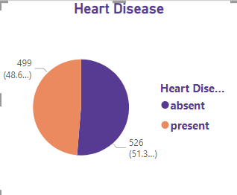
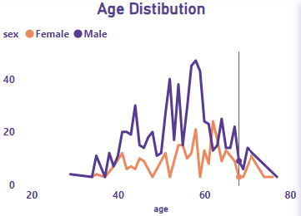
DATA VISUALIZATION
Type of population do we possess?
49% People suffering from heart disease.
More men are from age category >50 and females are from category >55

Slide 9
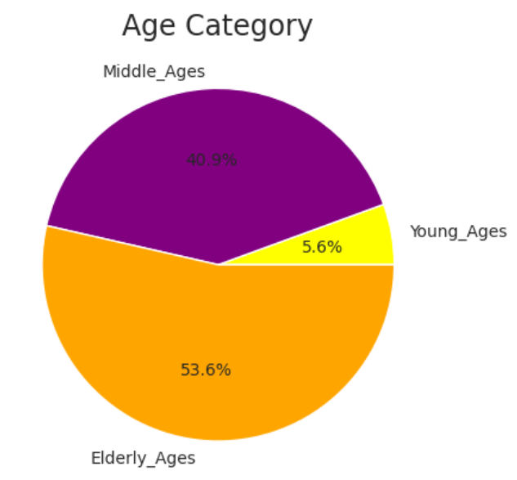
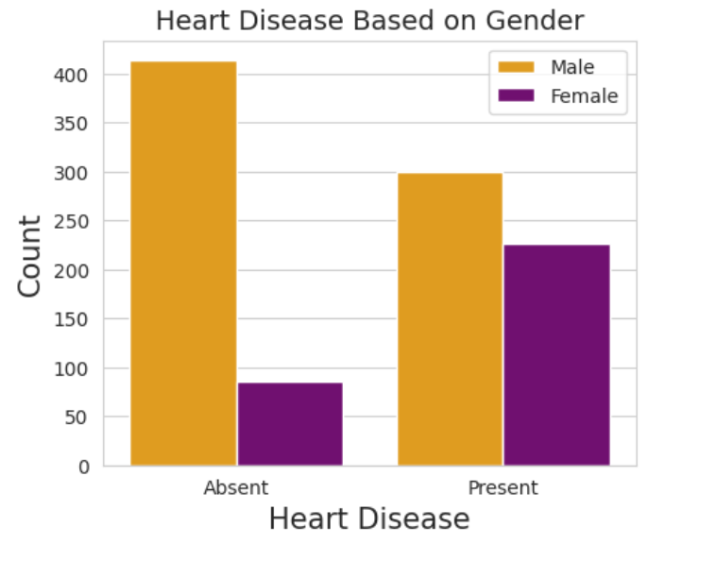
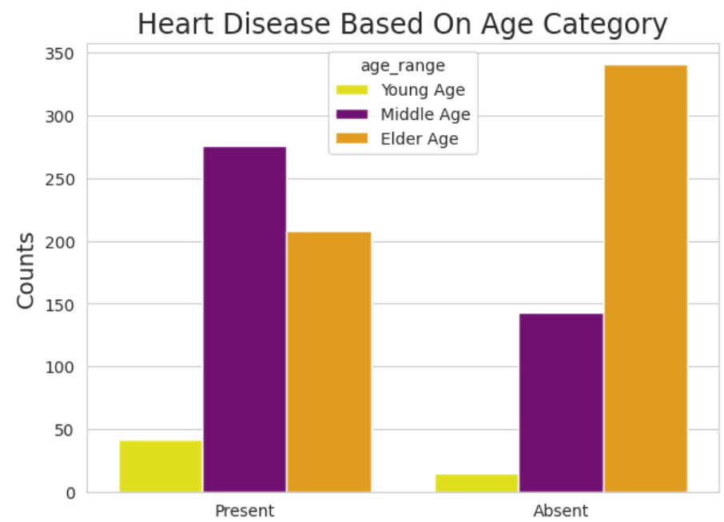
People Suffering from Heart Disease
Elderly Aged People are
more in our population
Males are more prone to
heart disease.
Middle Aged People are
more prone to heart disease.

Slide 10
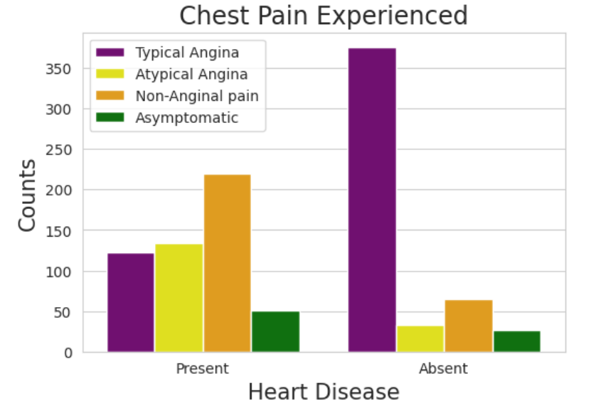
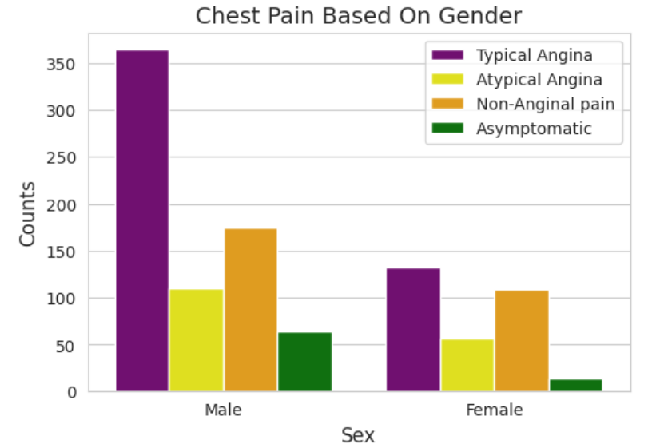
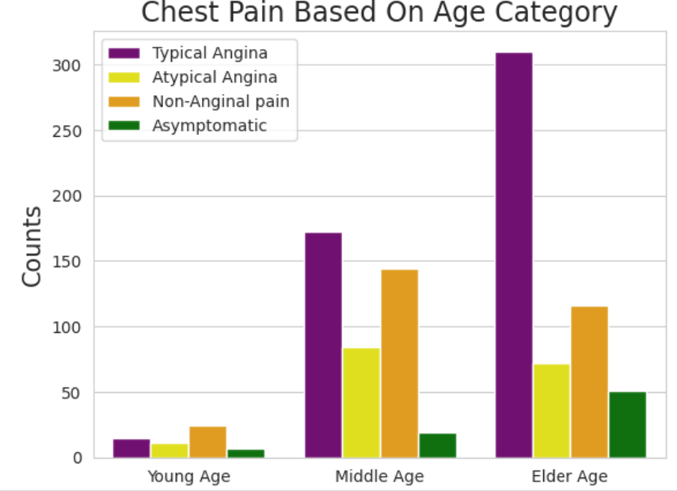
Chest Pain Experienced By Patients
It seems people having non anginal chest pain have a higher chance of heart disease.
We can see that a higher number of men are suffering from typical angina
There is very high number of typical angina in Elderly age Category
Typical angina do not cause symptoms of heart disease.

Slide 11
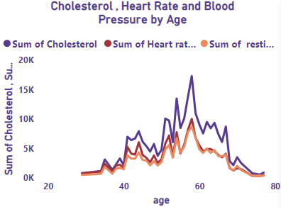
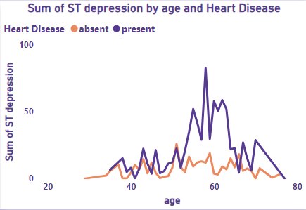
Different Symptoms people experience in heart disease
Here we can observe that Blood Pressure increases between age of 50 to 60 and somehow continue the pattern till 70.
Similarly, Cholesterol and maximum heart rate Increasing in the age group of 50-60.
we can observe from here that ST depression mostly increases between the age group of 55-65.

Slide 12
KEY PERFORMANCE INDICATOR (KPI)
Percentage of People Having Heart Disease
Age Distribution including Gender
Gender Distribution Based on Heart Disease
Chest Pain Experienced by People Suffering from Heart Disease
Blood Pressure, Cholesterol Level and Maximum Heart Rate of People According to their Age and Heart Disease Patients.
ST Depression Experienced by People According to their age and
heart disease.

Slide 13
CONCLUSION
Nearly half, or 49%, of the population is afflicted with heart disease.
Men aged between 50 and 60 years old are more prevalent, while women are more common in the 55 to 65 years category.
Males have a higher susceptibility to heart disease.
The elderly are more likely to develop heart disease.
Individuals with asymptomatic chest pain are at an elevated risk of heart disease.
There is a high prevalence of elevated cholesterol levels among individuals with heart disease.
Blood pressure tends to rise from the age of 50 to 60 and generally continues until 70.
There is an increase in cholesterol and maximum heart rate in the age group of 50-60.
ST depression is most commonly observed to increase between the ages of 30 and 40.

Slide 14
THANK YOU

